Slide 1

Group 14 Vikings vs Spartans
Level 4/5 Group 14: Ethan Ward, Petrut Vasile, Toby White

Slide 2
How we iterated based on feedback

Slide 3
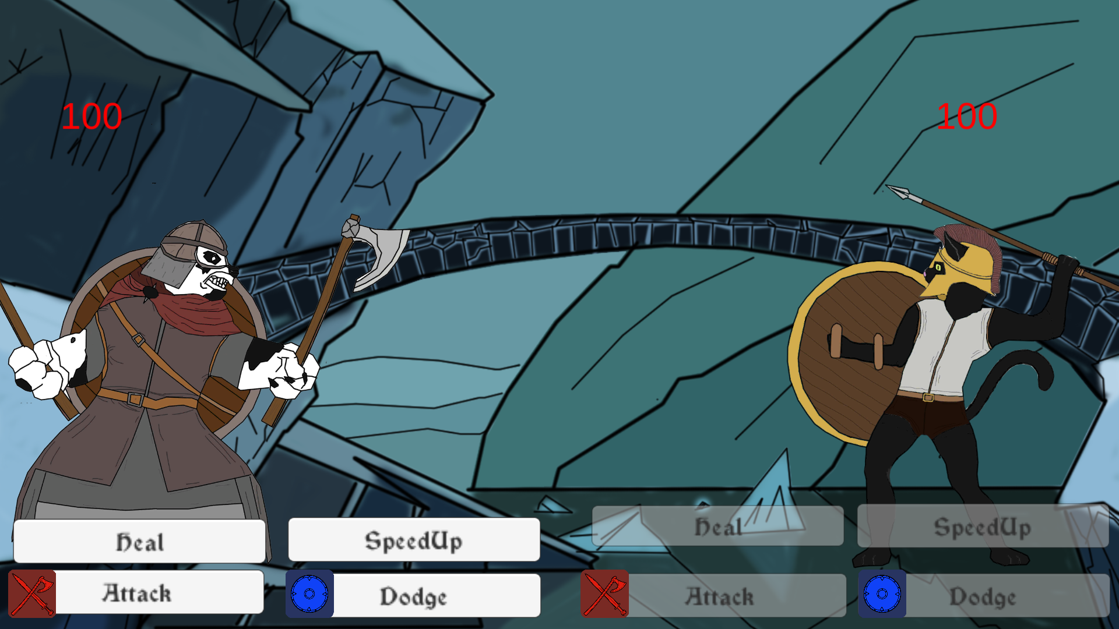
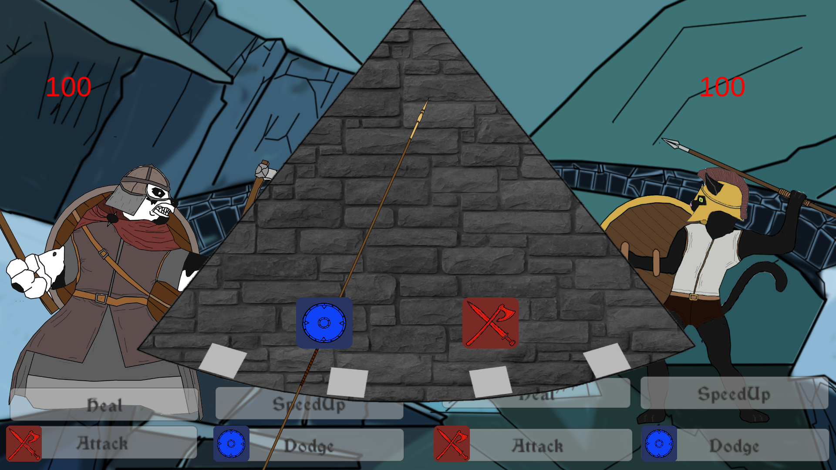
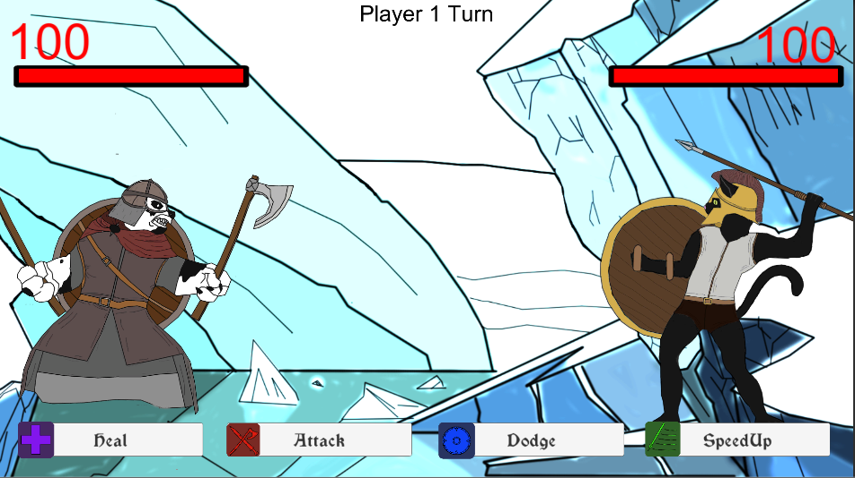
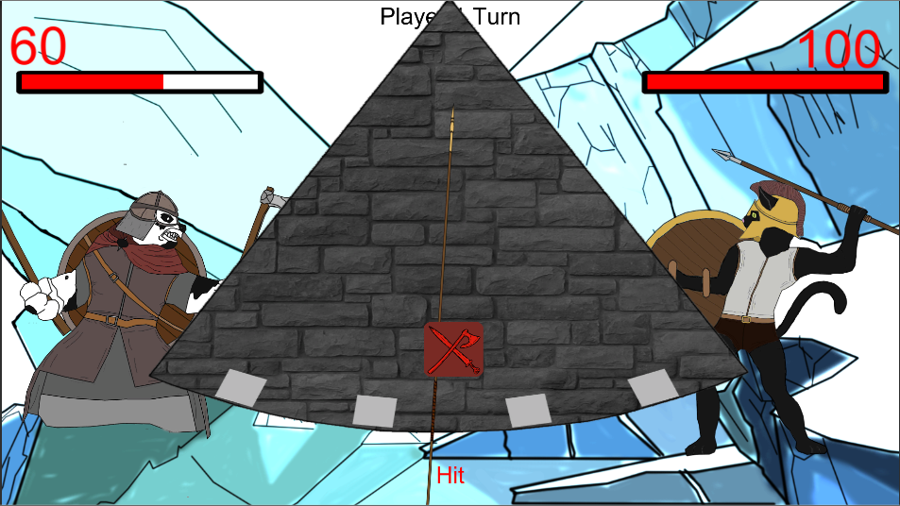
E
Notes:
Add in screen shot of buttons/symbols
And the single pendulum
Single set of buttons
More ways to play
More intuitive

Slide 4
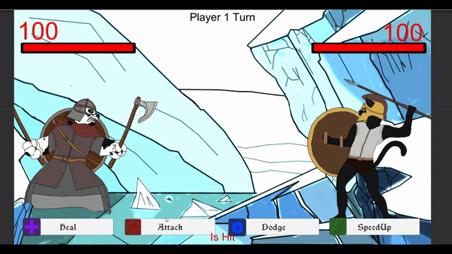
What does the player do?
P
Notes:
Thinking about removing the buttons in the main level as it is just another step for the player
Attack
Dodge
Speed up
Heal
Pendulum

Slide 5
The player experience & emotions
T
Desired emotions:
Joy, Fear.
Relief, Nervousness.
We aim for:
People Fun.
Notes:
On the side of the player experience, we aim for the primary emotions of Fear and Joy (joy for hitting and fear of the enemy hitting). The secondary emotions we target are the Relief and Nervousness, linked to the primary emotion of Fear.
Being a 2 player game, our first goal is to achieve a sense of people fun. This comes packaged with the emotion of schadenfreude
Having a twitch mechanic as out main game mechanic, we are of course expecting a sense of hard fun, bringing with it the emotion of Fiero.

Slide 6
What are the games challenges?
T
Strategical
Physical challenge
Twitch mechanic

Slide 7
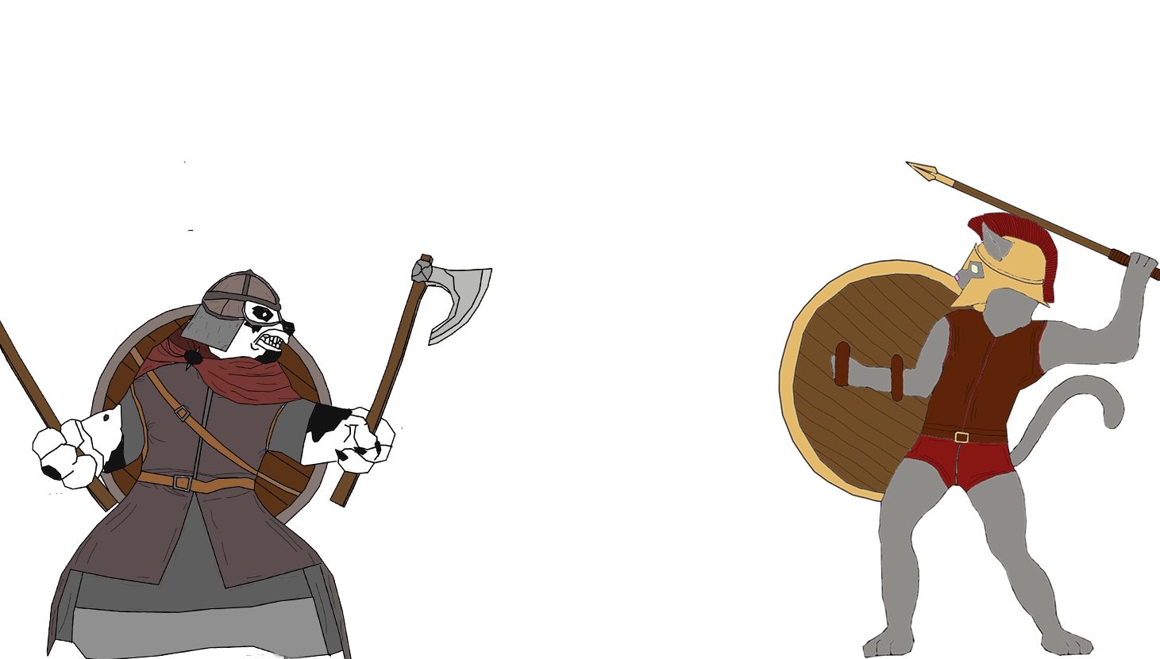
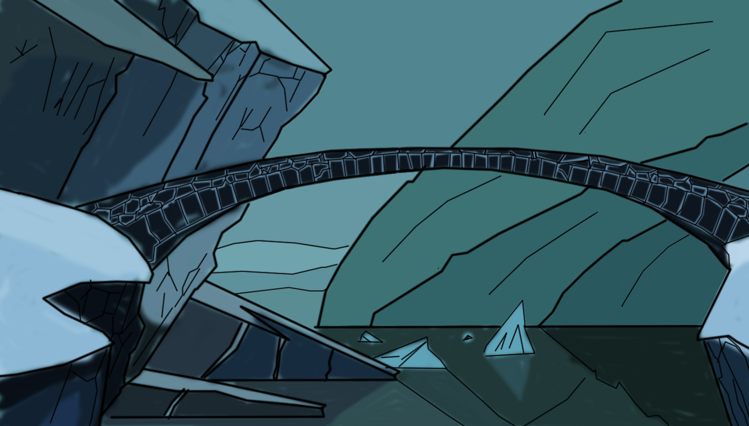
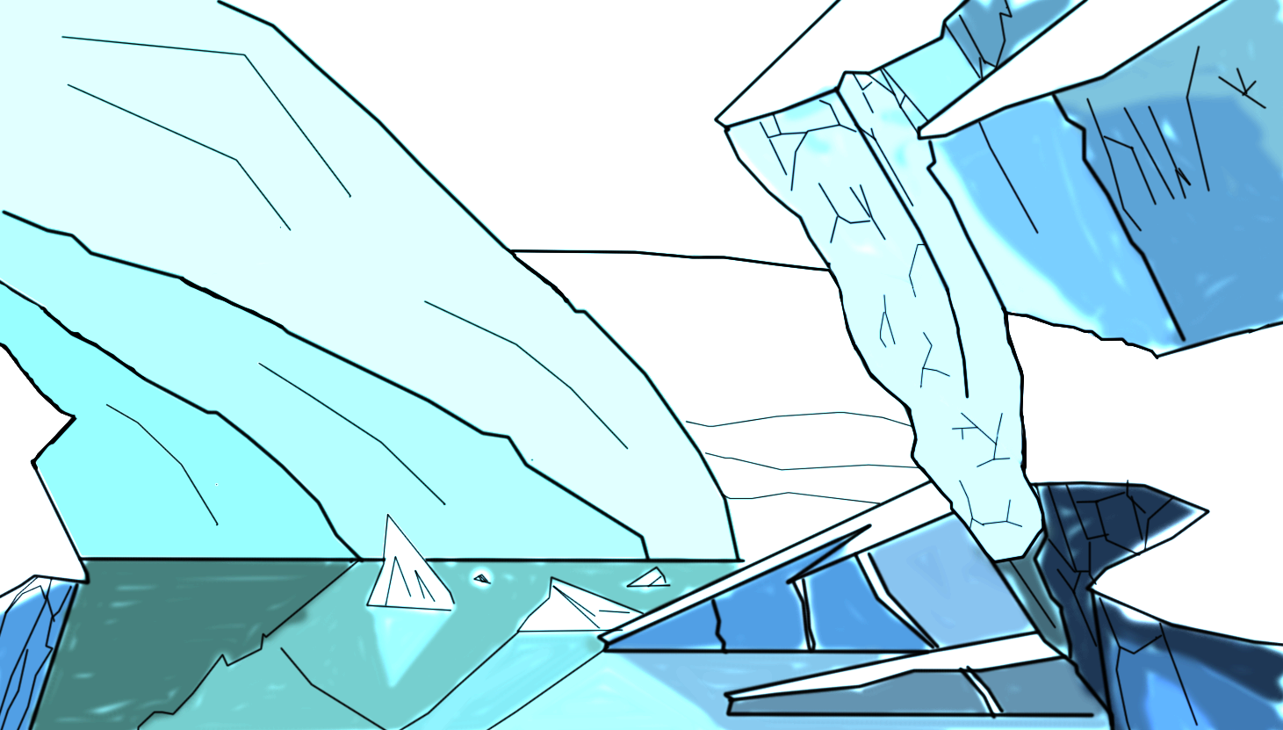
Art
T
Notes:
Removed the bridge as it was interrupting the screen
Monochromatic colour palette for background
High value, low saturation colours in comparison to the characters

Slide 8
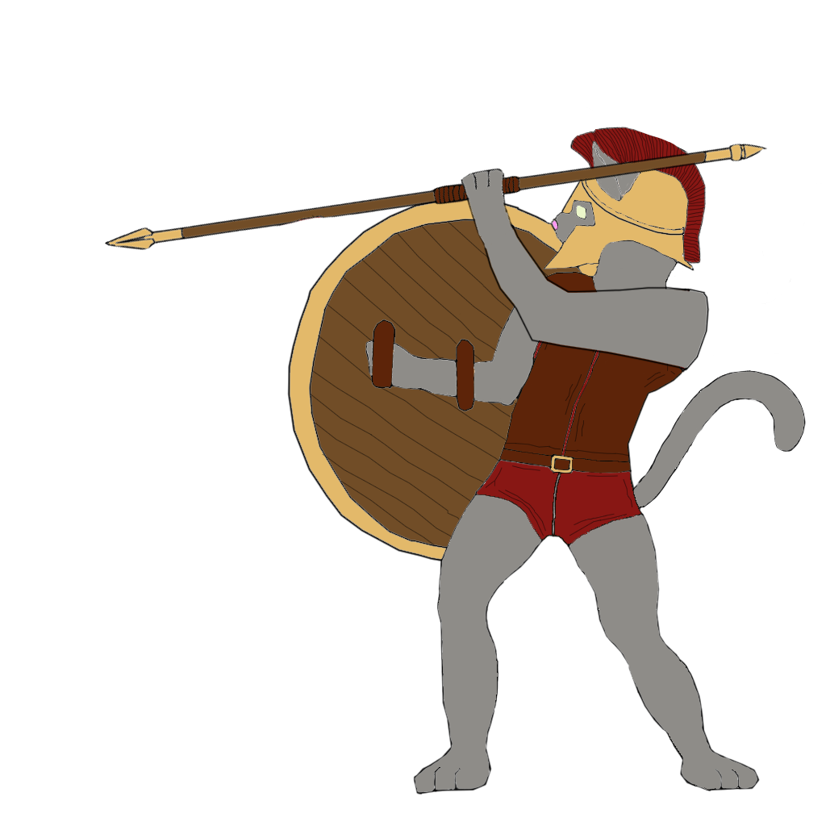
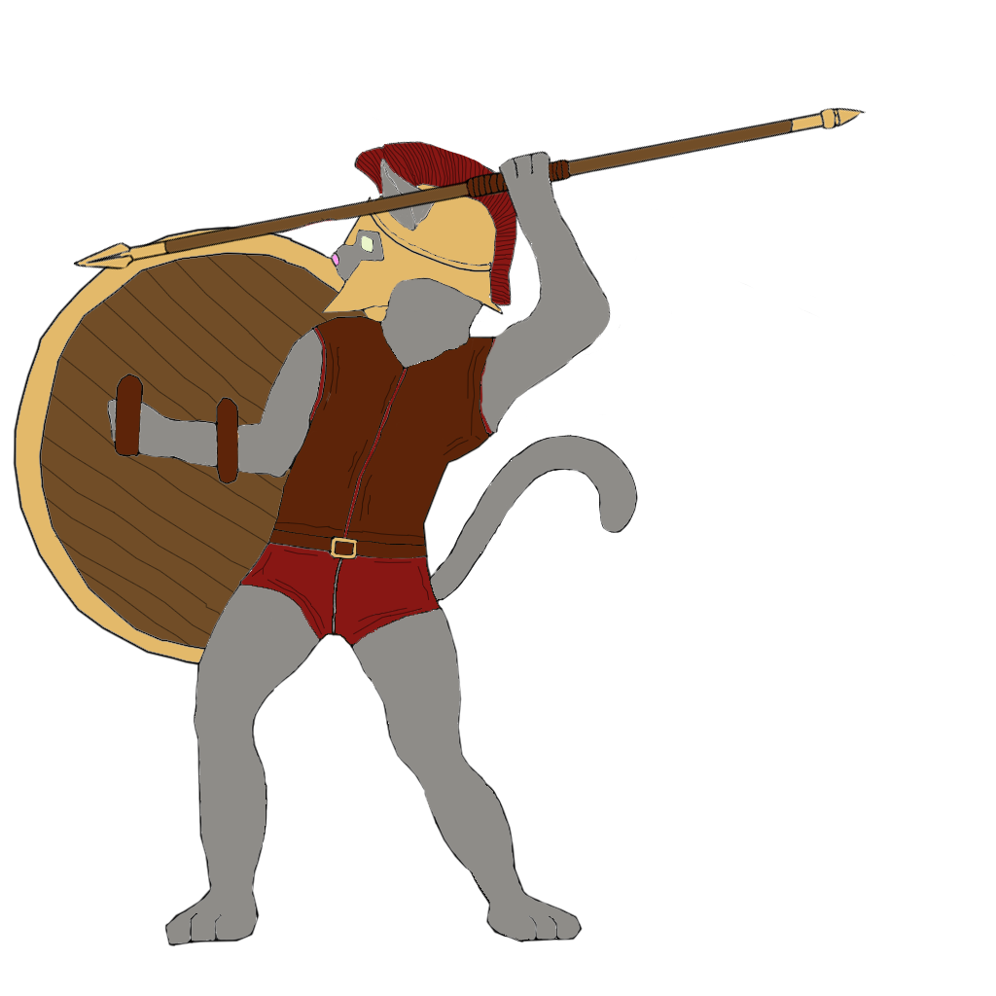
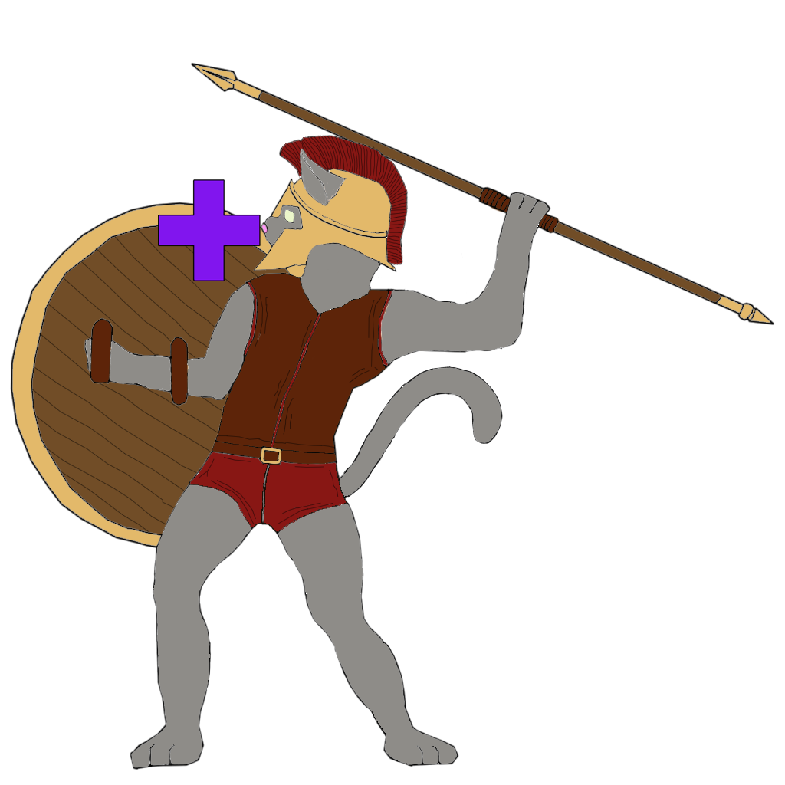
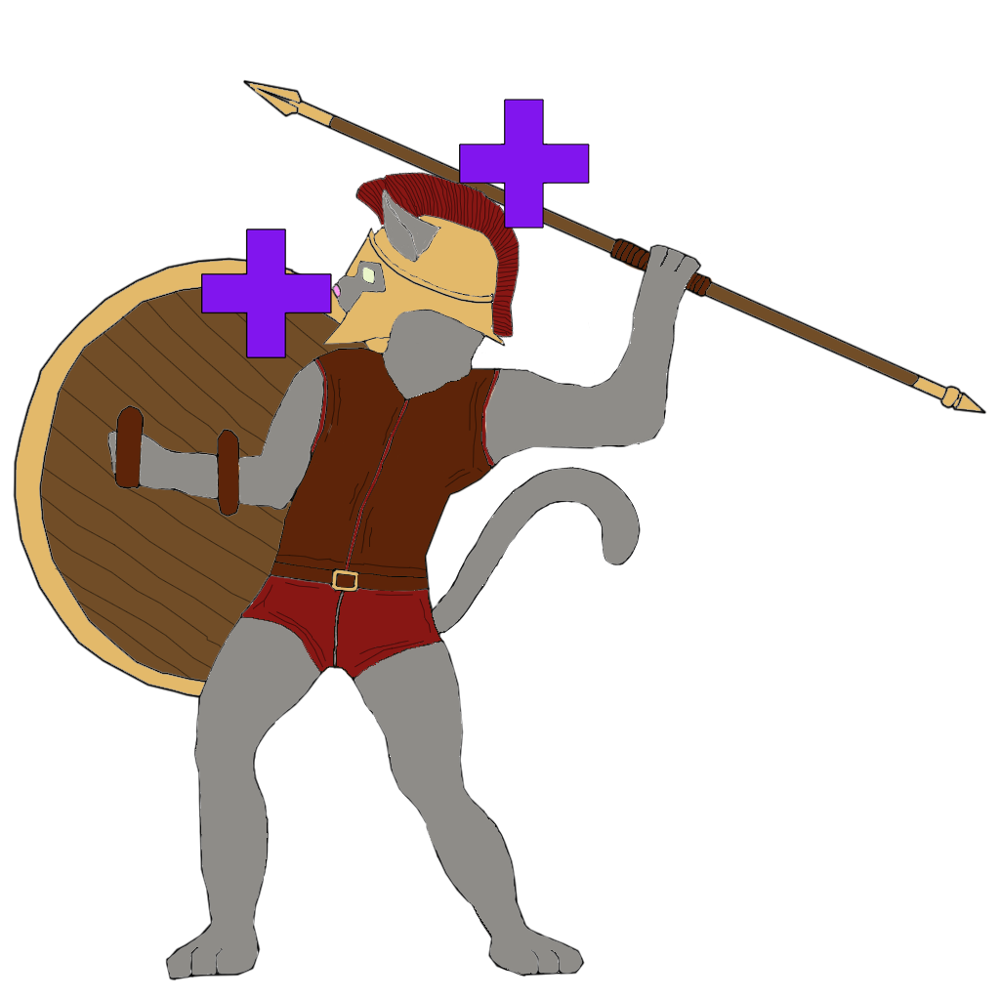
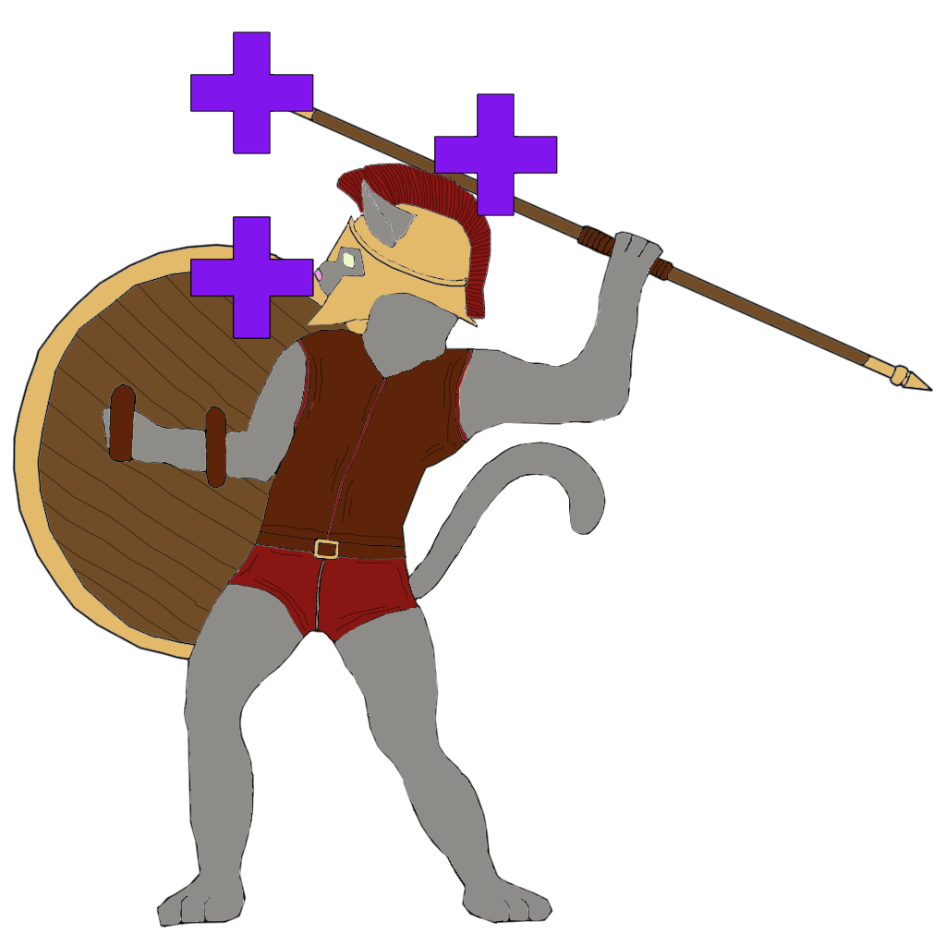
Art
T
Attack
Healing

Slide 9
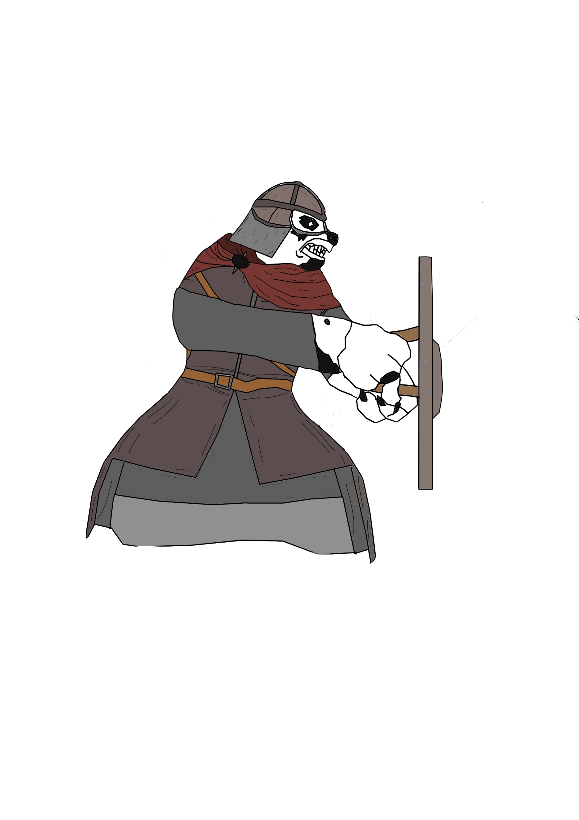
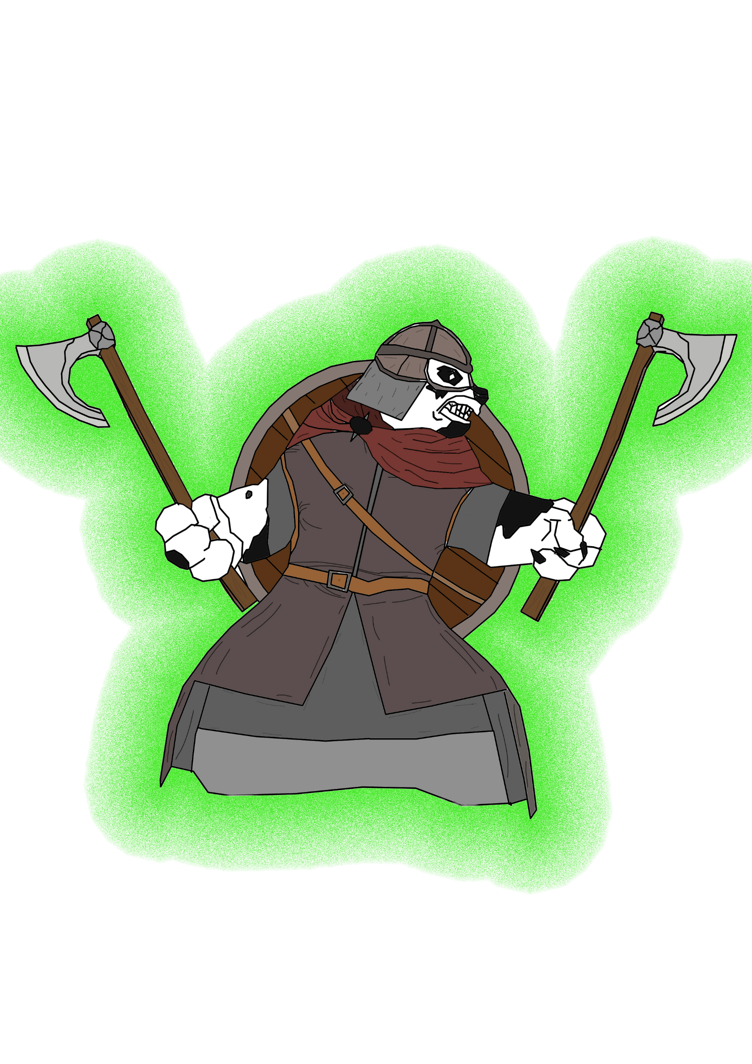
Art
T
Block
Speed up

Slide 10
The following week
E
&
P
Polishing the game
Balancing
Notes:
Improve the prototype based on player feedback
Finish the art for the game

Slide 11
Any Questions?

